Slide 1
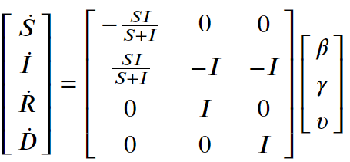
A Closer Look at how Non-Pharmaceutical Interventions Affect Transmission Rate in the SARS-CoV-2 Pandemic
TBD,TBD,TBD,TBD, Gentian Buzi
Department of Math and Computer Science, Biola University
Abstract
Data
Results
Methods/Approach
Conclusion
References

